Slide 1
Basics of Web Design Media & Interactivity Basics
Basics of Web Design: HTML5 & CSS, 6th Edition
Copyright © 2022

Slide 2
Learning Outcomes
Describe types of multimedia files used on the Web
Configure hyperlinks to multimedia files
Configure audio and video on a web page with HTML5 elements
Describe the purpose of geolocation, web storage, offline web applications, and HTML5 APIs

Slide 3
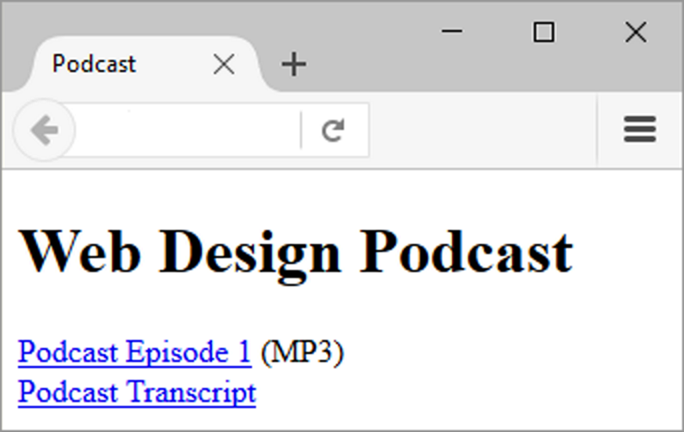
Configure Audio & Video
The most basic method to provide audio or video files:
Hyperlink
<a href="wdfpodcast.mp3" title="Web Design Podcast">Web Design Podcast</a>

Slide 4
Containers & Codecs
Container
Designated by the file extension – contains the media and metadata
Codec
The algorithm used to compress and decompress the media
HTML5 audio & video
Native to the browser
Browsers do not all support the same codecs

Slide 5
Copyright Issues
Only publish web pages, images, and other media that you have personally created or have obtained the rights or license to use.
Ask permission to use media created by another person instead of simply “grabbing” it.
All work (including web pages) are automatically copyrighted even if there is not copyright mark or date.
Fair Use Clause of the Copyright Act
Creative Commons – A new approach to copyright https://creativecommons.org/

Slide 6
Common Audio File Types
.aac, .mp4
MPEG 4 Audio
.mp3
MPEG-1 Audio Layer-3
.ogg
Ogg Vorbis (open-source)
.wav
Wave File

Slide 7
Common Video File Types
.av1, .mp4
Open-source, Alliance for Open Media, AV1 codec
.m4v, .mp4
MPEG-4, H.264 codec
.mov
Quicktime MPEG-4 codec
.mov, .mp4, .hevc
High-efficiency Video Coding, H.265 codec
.ogv, .ogg
Open-source. Ogg Theora (open-source), Theora codec
.webm
Open media format, VP8 & VP9 codecs

Slide 8
Multimedia & Accessibility
Provide alternate content
Transcript (for audio)
Captions (for video)
Text format

Slide 9
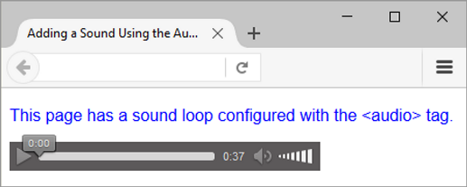
HTML5 Audio & Source Elements
<audio controls>
<source src="soundloop.mp3" type="audio/mpeg">
<source src="soundloop.ogg" type="audio/ogg">
<a href="soundloop.mp3">Download the Audio File</a> (MP3)
</audio>

Slide 10
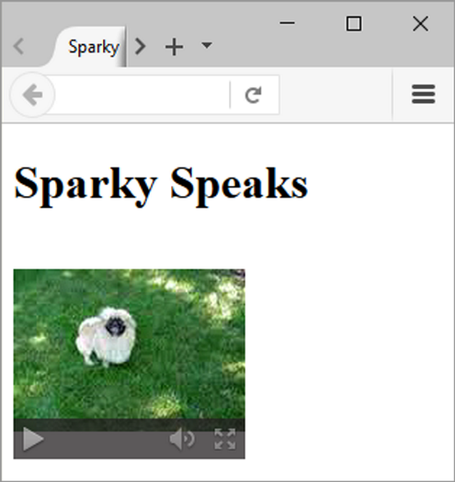
HTML5 Video & Source Elements
<video controls poster="sparky.jpg"
width="160" height="150">
<source src="sparky.m4v" type="video/mp4">
<source src="sparky.ogv" type="video/ogg">
<a href="sparky.mov">Sparky the Dog</a> (.mov)
</video>

Slide 11
Code demo XBI

Slide 12
HTML5 APIs
API – a protocol that allows software components to communicate – interacting and sharing data
A variety of APIs that are intended to work with HTML5, CSS, and JavaScript are currently under development and in the W3C approval process, including:
geolocation
web storage
service workers
Canvas
https://www.w3schools.com/html/html5_geolocation.asp

Slide 13
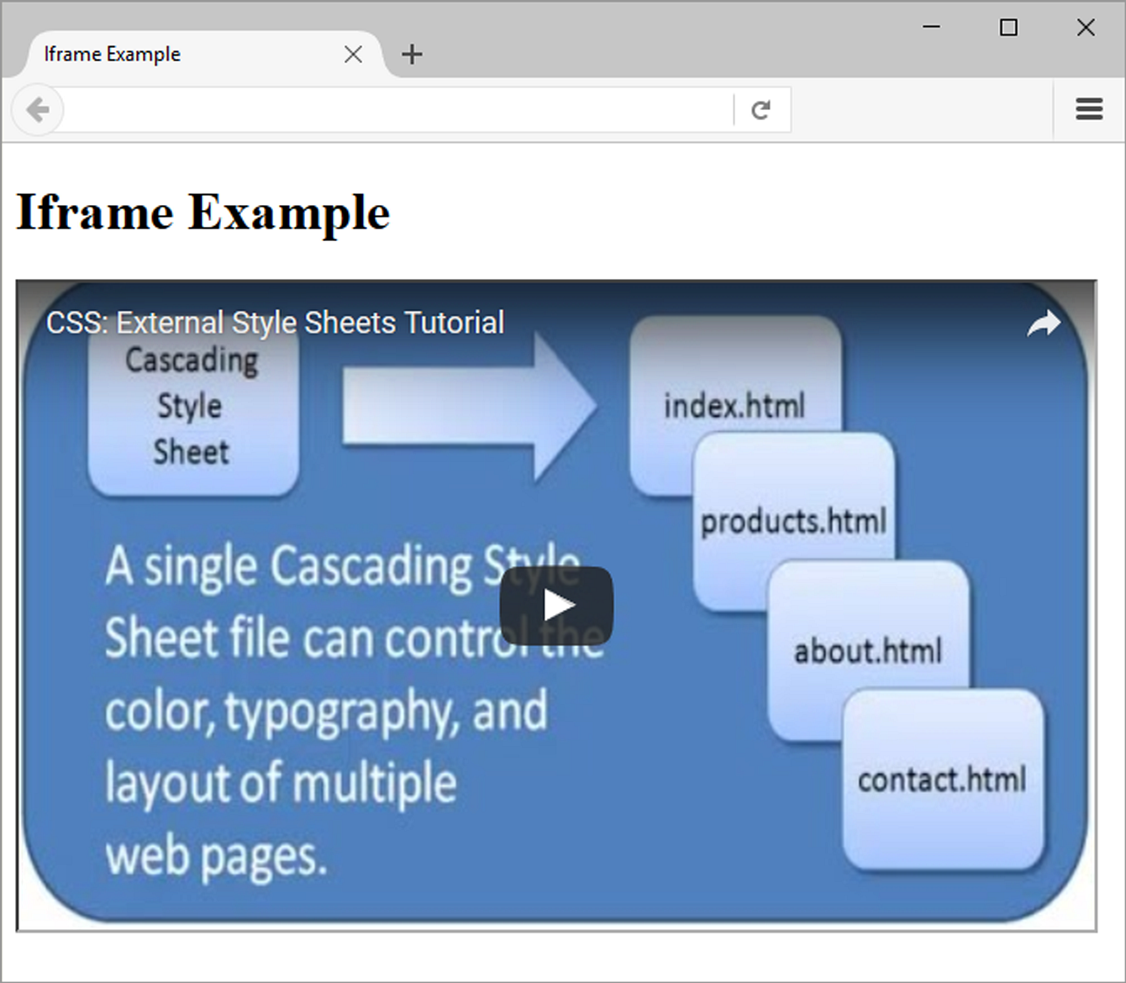
Use the iframe element to embed a video
<iframe src="https://www.youtube.com/embed/2CuOug8KDWI"
width="640" height="385" allowfullscreen>
</iframe>

Slide 14
Progressive Web Application (PWA)
A web application (app) can be written with HTML, CSS and JavaScript and can run in any browser – as long as you are online.
Progressive Web Application (PWA)
Rich user experience similar to an iPhone or Android app
Provides some level of functionality even when offline
Key APIs:
Manifest API Provides information about the PWA; including the data needed for the PWA's icon to be added to the home screen of a device.
Service Workers API JavaScript that runs in the background; Provides for push notifications and background data syncing; Requires HTTPS

Slide 15
Summary
This chapter introduced the HTML techniques and technologies used to configure sound, video, and interactivity on web pages.
Issues related to accessibility and copyright were also discussed.
The number one reason for visitors to leave web pages is too long of a download time. When using multimedia, be careful to minimize this issue.

Slide 16
HTML code validation
https://validator.w3.org/
W3.org, short for the World Wide Web Consortium, is an international organization dedicated to developing web standards.

